Slide 1
FPAC Response to charge S1909-1
Searches for University Leadership

Slide 2
The charge:
Investigate the processes, including those used by the Big 10 and AAU Institutions, to identify senior leaders and recommend best practices at Rutgers.

Slide 3
Background:
In the latest search for the university president the BOG formed a search committee without getting input from the Senate or the university student/faculty/staff
Identities of members of this search committee were not made public, although the BOG assured the Senate that faculty were involved in the committee
The Senate EC created this charge for the FPAC so that the committee examines the search process for the senior leadership hiring
Upon request for further clarification, the Senate President and Vice President stressed that the scope of this charge is intentionally broad and it is up to FPAC to decide which leadership categories they wish to cover

Slide 4
What peer institution do
We sent e-mail to several Senate presidents from the Big ten, the PAC ten and some other large and well-known peer state universities, asking about their president and other senior leadership search process
Among those who responded were
The University of Michigan
The University of Wisconsin
Pennsylvania State University
University of Maryland
University of California-Berkeley
Some Responses and policies follows:

Slide 5
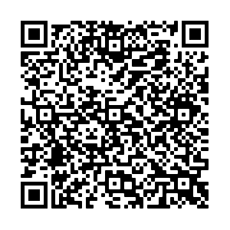
University of Wisconsin
The Board of Regents appoints the search committee for search of University-wide President
The President appoints committee for search of Campus Chancellor
There are quotas:
Five are from the Board itself
Two faculty, and one staff and one student
President of search committee is chosen by the board from a board member
Vice president is chosen from one of faculty members
https://www.wisconsin.edu/regents/policies/selection-process-for-system-president-chancellors-vice-chancellors-and-uw-system-senior-leadership-positions/

Slide 6
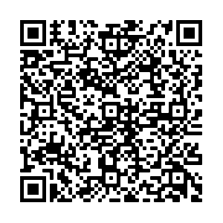
University of Minnesota
The Board of Regents is the search committee
They consult with the University Senate and get advice to add faculty/staff/student members to the search committee
They ask for up to twice as many proposed members of search committee so that they have “flexibility” to choose
The Senate special committee and “representatives” of faculty, staff, students are allowed to participate in the finalists interviews
https://humanresources.umn.edu/sites/humanresources.umn.edu/files/sup034-04_university_senate_committee_involvement_in_hiring_selected_leaders_tc_morris_rochester.pdf

Slide 7
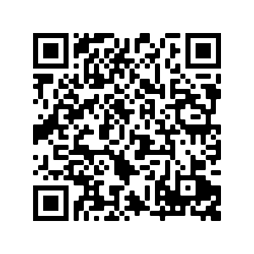
University of Maryland
At Maryland, the search committee is appointed by the Board of Regents
The names of members of search committees are made public
Many are from the Board itself, or the administration (deans, University Counsel,) or from donors
https://umd.edu/presidential-search/presidential-search-process/search-committee

Slide 8
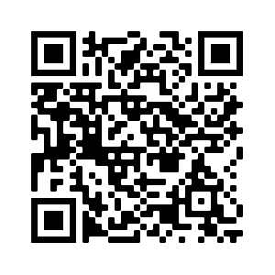
University of California-Berkeley
In the last Search for Berkeley Chancellor in 2016 The UC System President appointed the search committee
She selected five faculty members(one who is the Senate chair, and one from a UC campus other than Berkeley,) and one each from undergrad students, grad students, staff, UC foundation and alumni
https://chancellor.berkeley.edu/uc-berkeley-chancellor-selection-faq

Slide 9
Communication with the University of Michigan Director of Faculty Senate
Dear Professor Alizadeh,
The University of Michigan is beginning the process of examining its practices concerning hiring of deans and other high level administrators, so we don't currently have best practices to share. We had a scandal last year where UM's provost was embroiled in sexual harassment issues of his own. The provost ascended through the faculty ranks, served as a dean, and then was appointed as provost after years of inappropriate behavior that went unchecked. As a result, the Board of Regents hired a consulting firm in December that will be with us at least through the end of the year. I expect at the end of this process we will have robust procedures, but it will be a while.
I would very much appreciate hearing about what you learn from our peers if you're willing to share what you learn. When we come to the end of this process, I will be more than happy to share what procedures UM will put into place.
Good luck with this important work before you!
Best regards,
MaryJo
MaryJo Banasik, J.D., Ph.D.
Director, Faculty Senate Office

Slide 10
The FPAC Resolution
After considerable debate and discussion the following resolution regarding composition of search committees for senior leadership searches is proposed by the FPAC
Here are the highlights:
For President and chancellors:
university/campus wide volunteers announce their interest.
A Senate ad hoc committee selects a short list
Senators vote for the student/staff/faculty members of the committee
The BOG/President must accept all as part of the eventual search committee
For Deans:
Unit-wide election for student/staff/faculty of the unit
The Chancellor must accept all as part of eventual search committee
The identities of members of search committees should be made public along with their CV/Resume

Slide 11
For the Executive Vice President and Provosts
The suggested appointee has to be announced at least two Senate sessions before the formal appointment
University community can send their questions/concerns/praise to the Senate
The Senate collects and summarizes them and communicates them to the President/Chancellor
The President/Chancellor should come before the Senate and address these questions

Slide 12
Draft Resolution for Charge S1909-1
In the interest of shared governance be it resolved that:
1) For the search of the University president:
A university-wide announcement shall be made, and a call for nominations for the search committee shall be solicited. The invitation shall be extended to all the university faculty, students, and staff with at least one year of university participation prior to committee formation. Nominations shall be open to all faculty (including PTL's), students, and staff who meet eligibility conditions to be in the University Senate.
The Executive Committee of the University Senate shall form a special committee to review all search committee candidates based on diversity, representation, and eligibility. The Senate committee shall form a shortlist of search committee candidates and present it to the Senate.
The Senate shall vote on the search committee candidates from the shortlist and select a list of candidates whose number is equal to the number of the eventual search committee's student/faculty/staff members.
The Senate shall present its elected search committee candidates to The Board of Governors. The BOG shall include all the Senate elected members in the eventual search committee.
The identities of all members of the eventual search committee shall be made public along with a biography and relevant CV or resume.

Slide 13
2) For the search of University campus chancellors:
A campus-wide announcement shall be made, and a call for nominations for the search committee shall be solicited. The invitation shall be extended to all the campus faculty, students, and staff with at least one year of university participation prior to committee formation. Nominations shall be open to all faculty (including PTL's), students, and staff who meet eligibility conditions to be in the University Senate.
The Executive Committee of the University Senate shall form a special committee to review all search committee candidates based on diversity, representation, and eligibility. The Senate committee shall form a shortlist of search committee candidates and present it to the Senate.
The Senate shall vote on the search committee candidates and select a list of candidates whose number is equal to the number of the eventual search committee's student/faculty/staff members.
The Senate shall present its elected search committee candidates to The University President. The President shall include all the Senate elected members in the eventual search committee.
The identities of all members of the eventual search committee shall be made public along with a biography and relevant CV or resume.

Slide 14
3) For the search of University schools and other decanal units' deans:
An announcement shall be made by the Chancellor of the campus where the decanal unit is based, and nominations for the search committee shall be solicited from among the unit's students, faculty, and staff.
Elections shall be conducted among the decanal unit's students, who will vote for the student representatives in the search committee.
Elections shall be conducted among the decanal unit's faculty (including TT, NTT, and PTL's), who will vote for the faculty representatives in the search committee.
Elections shall be conducted among the decanal unit's staff, who will vote for the staff representatives in the search committee.
The decanal unit's dean shall present the results of these elections to the Chancellor of the campus to which the unit belongs.
The Chancellor must include the elected student/staff/faculty (including PTL's) as part of the eventual search committee.
The identities of all eventual dean search committee members shall be made public along with a biography and relevant CV or resume.

Slide 15
4) For the appointment of the University Executive Vice President:
The university president shall announce his/her choice for the EVP to the public and wait for at least two Senate sessions to make the appointment final.
The biography and CV or resume of the proposed EVP shall be made public by the president.
The university students/faculty/staff shall have an opportunity to examine the proposed candidate and, if there are questions, concerns, or objections, shall present them to the University Senate.
The University Senate shall summarize these concerns and present them to the University President.
The university president shall appear before the Senate and address the questions, concerns, and objections raised by the university community.

Slide 16
5) For the appointment of campus Provosts:
The campus chancellor shall announce his/her choice for the provost to the public and wait for at least two Senate sessions to make the appointment final.
The biography and CV or resume of the proposed provost shall be made public by the chancellor.
The campus students/faculty/staff shall have an opportunity to examine the proposed candidate and, if there are questions, concerns, or objections, shall present them to the University Senate.
The University Senate shall summarize these concerns and present them to the campus chancellor.
The campus chancellor shall appear before the Senate and address the questions, concerns, and objections raised by the campus community.
6) The Senate shall put in place processes to administer both the election process for the president and chancellors’ search committees. The Senate shall also put in place process to convey the faculty/staff/students’ inputs to the president and chancellors for their appointed EVP and provosts.

