Slide 1
Camden Chancellor’s Report to the University Senate
Friday, April 29, 2022
Notes:
Good afternoon and welcome to the Chancellor’s Spring Address. All of us gather here today is a testament…

Slide 2
National Recognition
from 153 in 2021
from 166 in 2020
148
Among National Research Universities
18
Top Performers
on Social Mobility
from 26 in 2021
67
from 71 in 2021
Top Public Universities
U.S. News & World Report 2022 rankings

Slide 3
Total Enrollment Numbers
6,451
Total Enrollment
YTD Fall 2022*
6,718 in fall 2021
11%
Decrease in Undergraduate Enrollment
4,635 in fall 2022
4,856 in fall 2021
8%
Increase in Graduate Enrollment
1,816 in fall 2022
1,714 in fall 2021
55%
Undergraduates who are First-Gen Students
*Projected Number

Slide 4
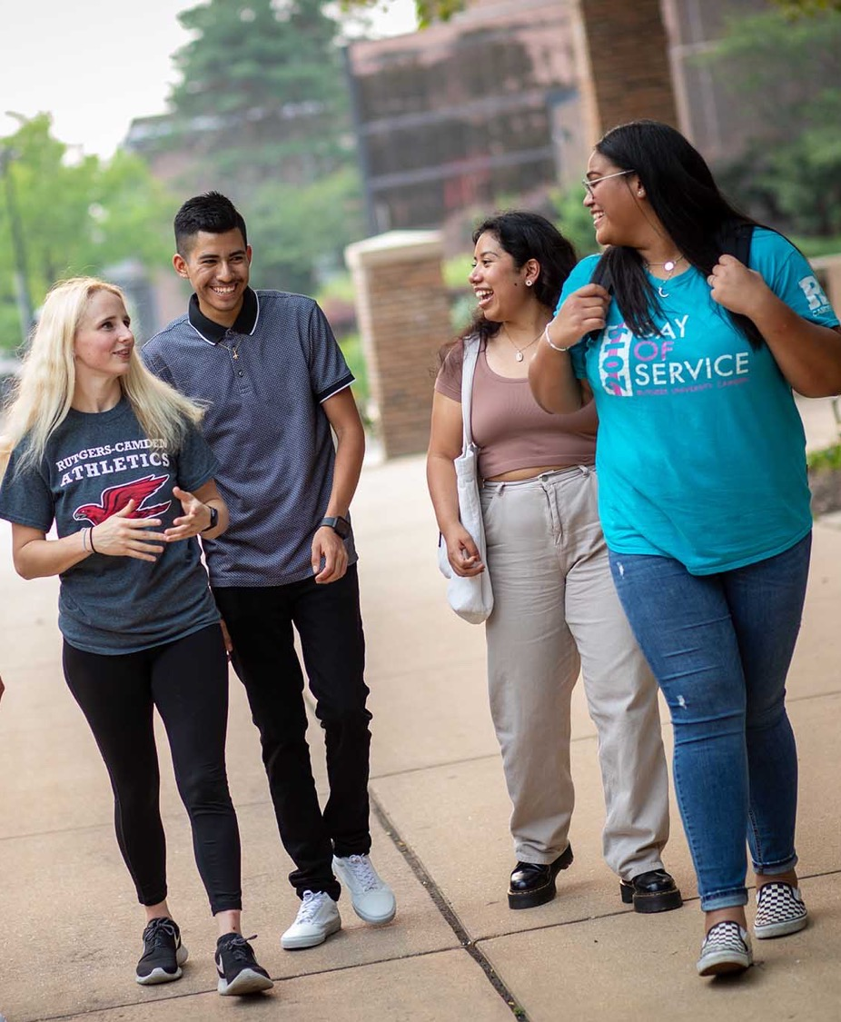
Diversity, Equity, and Inclusion
diversity.rutgers.edu/university-plan

Slide 5
Diversity, Equity, and Inclusion
2022 Diversity, Inclusion, and Civic Engagement Awards
IDEA Innovation Grants
Launch of Truth, Racial Healing, and Transformation Center
Establishment of the DEI Council and Diversity Strategic Plan
Inaugural Rites of Passage Ceremony

Slide 6
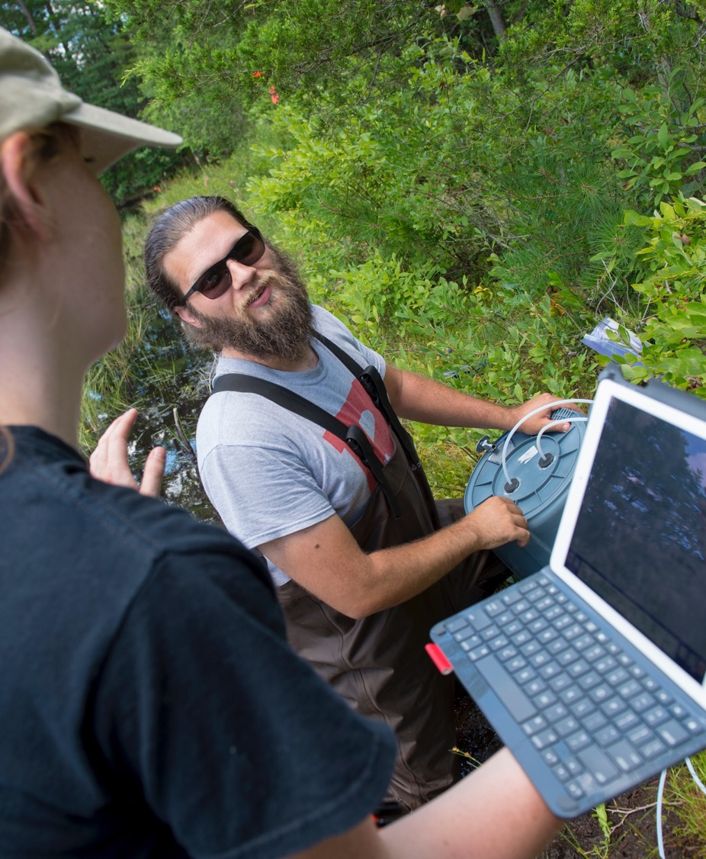
Research

Slide 7
Sponsored Research
$20.3M
Total Research Dollars
FY2021
$20.4M FY2020, -0.5%
21%
Increase in Funded Awards FY2021
22% FY2020

Slide 8
Advancement

Slide 9
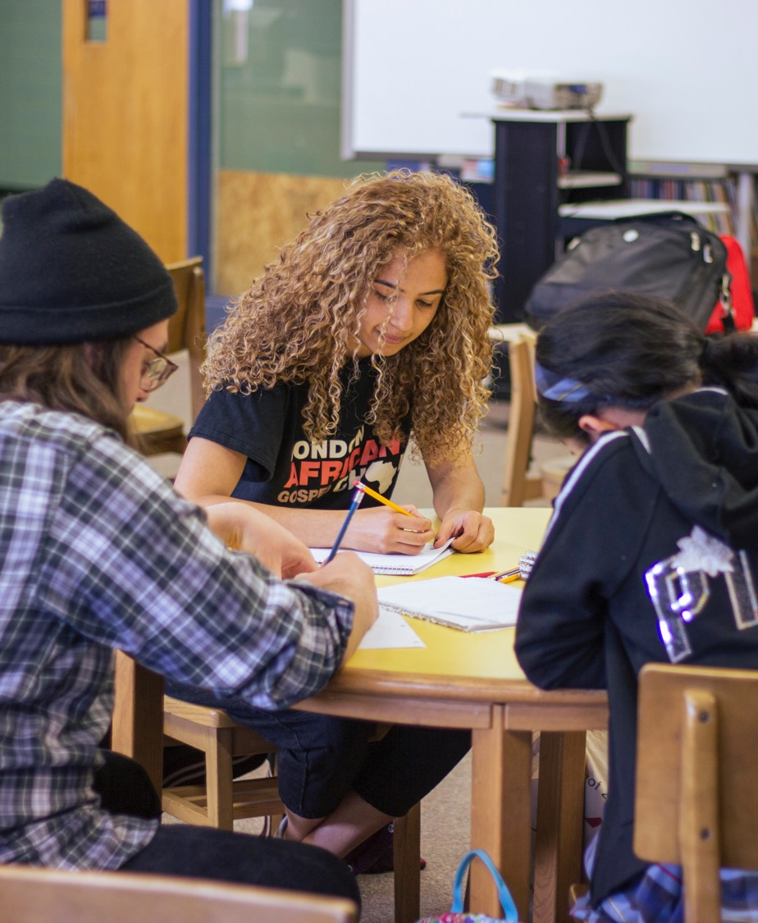
Civic Engagement

Slide 10
Civic Learning, Civic Leading
125 engaged civic learning courses
111 trained faculty fellows who teach engaged civic learning courses
530 students in grades 3–12 are currently being served
300,000 hours spent by students in the community

Slide 11
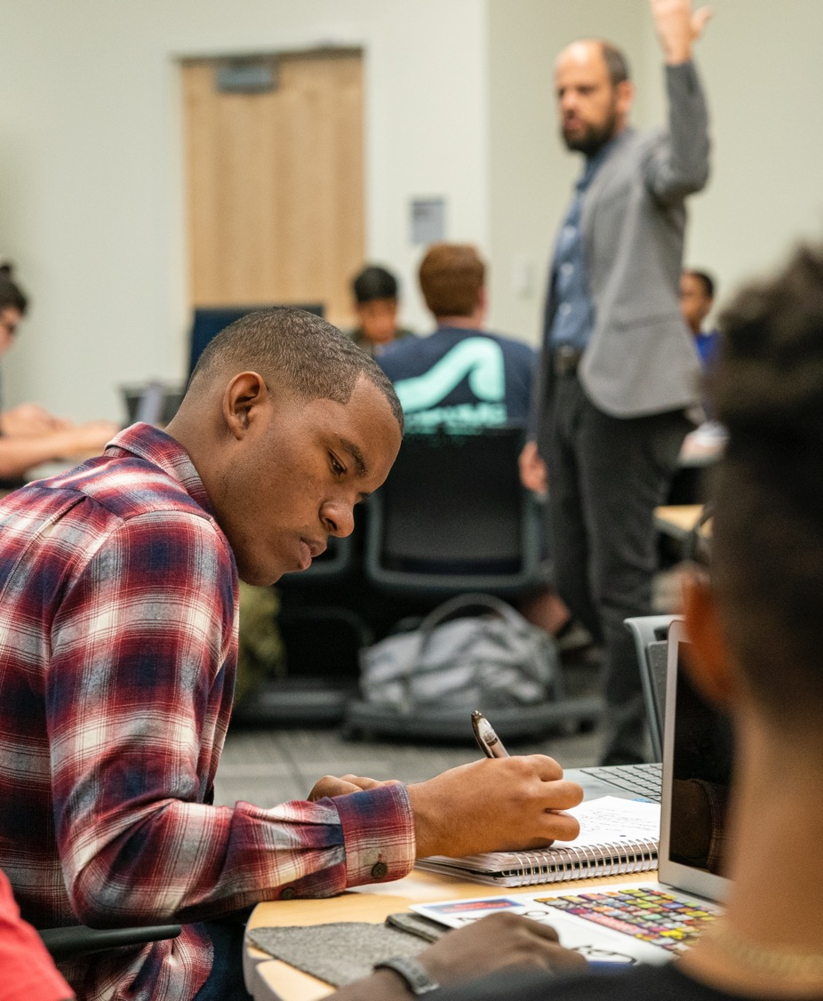
Student Success

Slide 12
Student Success
New Highs in Graduation Rates
41%
Four-Year
Graduation Rate
65%
Six-Year
Graduation Rate
First-Generation Students
94%
Receive
Financial Aid
3.19
Average GPA
All Undergraduate Students
71%
Baseline Retention Rates for
First-to-Second Years

Slide 13
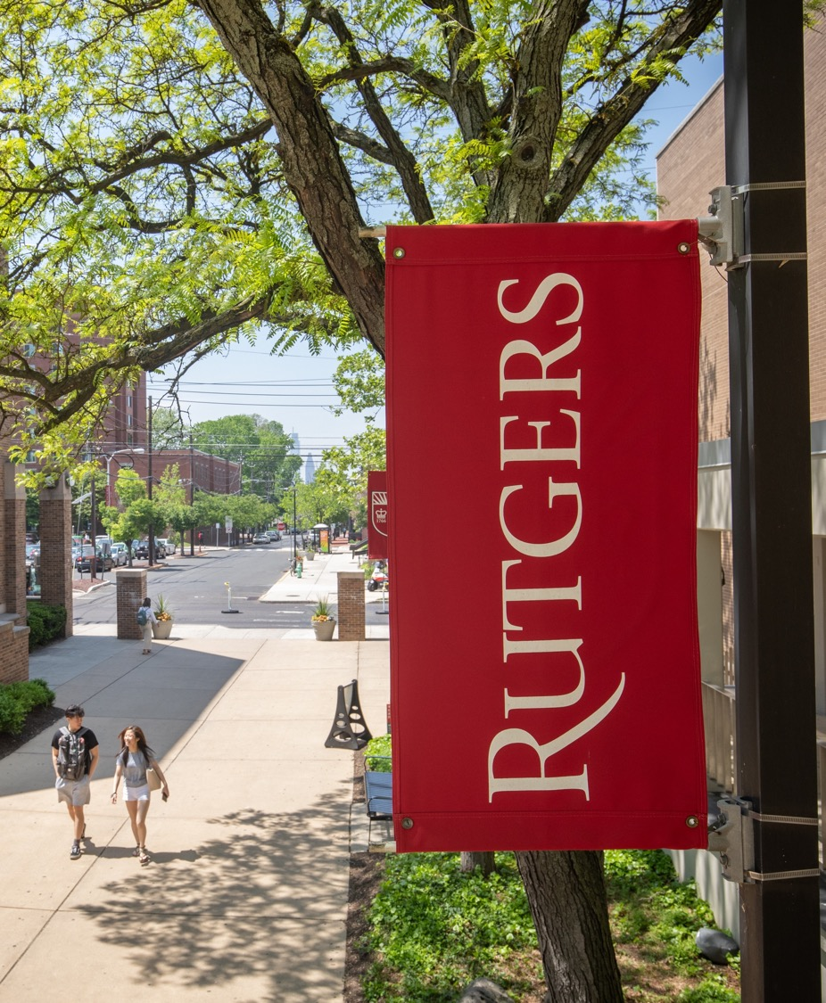
FY2023 Initiatives

Slide 14
FY2023 Initiatives: Preparing for Growth
Community Partnerships
Rutgers‒Camden and the City of Camden Partner to Create New Chancellor Mayoral Internship Program
Rutgers–Camden and Camden County College Create L.P.N. to R.N. to B.S.N. Pipeline with School of Nursing
Congress Allocates $234,000 to Rutgers–Camden Program Benefitting K–12 Students of Color Impacted by the Pandemic
Increase Global Footprint
Engagement with Cairo, Egypt
Engagement with Cape Town and Johannesburg, South Africa
July 2021 – to date
Engagement with Brazil and Paraguay, South America

Slide 15
FY2023 Initiatives: Preparing for Growth
Onboard New Undergraduate and Graduate Degree-Granting Programs
Bachelor of Fine Arts (B.F.A.) in Visual Art
Master of Science (M.S.) in Finance-Wealth Management
Master of Arts (M.A.) and Master of Professional Studies (M.P.S.) degrees in Emerging Media
Master of Science (M.S.) in Data Science
Ph.D. and Master of Science (M.S.) in Prevention Science
Establish Developmental Opportunities for Faculty, Staff, and Students

Slide 16
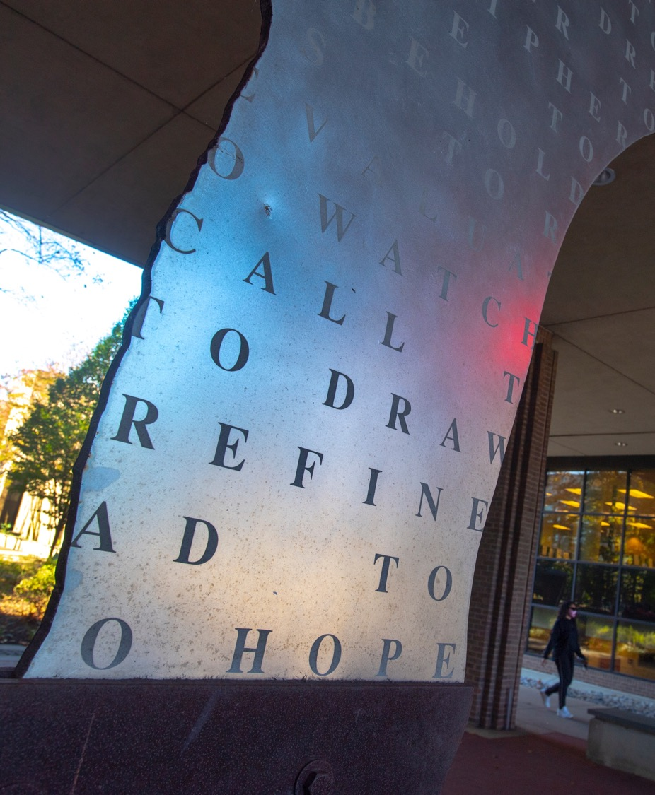
Chancellor’s Strategic Initiatives: “15 in 5”

Slide 17
Chancellor's Strategic Initiatives: “15 in 5”
The five-year strategic initiative plan, “15 in 5”, focuses on chancellor-level competitive grants and awards to advance the student educational experience and to support the advancement and development of faculty and staff. The goal is to implement and sustain these initiatives within five years. The strategic initiatives align with the core mission and values of Rutgers University–Camden as an urban research institution dedicated to excellence and committed to community.
$5,000,000 INVESTMENT

Slide 18
Chancellor's Strategic Initiatives: “15 in 5”
Launched
Chancellor’s Learning Abroad Course Scholarship
Chancellor Mayoral Internship Program
Chancellor’s Grant for Staff Development
Chancellor’s Lecture Series on Global Racial Reckoning and Civility

Slide 19
Chancellor's Strategic Initiatives: “15 in 5”
To be launched AY’23
Chancellor’s Distinguished Visiting Scholar
Chancellor’s Grant for Interdisciplinary Research Collaboration
Chancellor’s Grant for Post-Doctoral Studies
Chancellor’s Grant for Independent Student Research
Chancellor’s Grant for Faculty Development in Administrative Roles
Chancellor’s Grant for Pedagogical Innovation
Chancellor’s Grant for Assistant Professor Research Development
Chancellor’s Grant for Faculty Research (Supplement to Provost)
Chancellor’s Research Grant for Part-Time Lecturers (PTL)
Chancellor’s Faculty Book Completion Grant
Chancellor’s Dissertation Completion Award

Slide 20
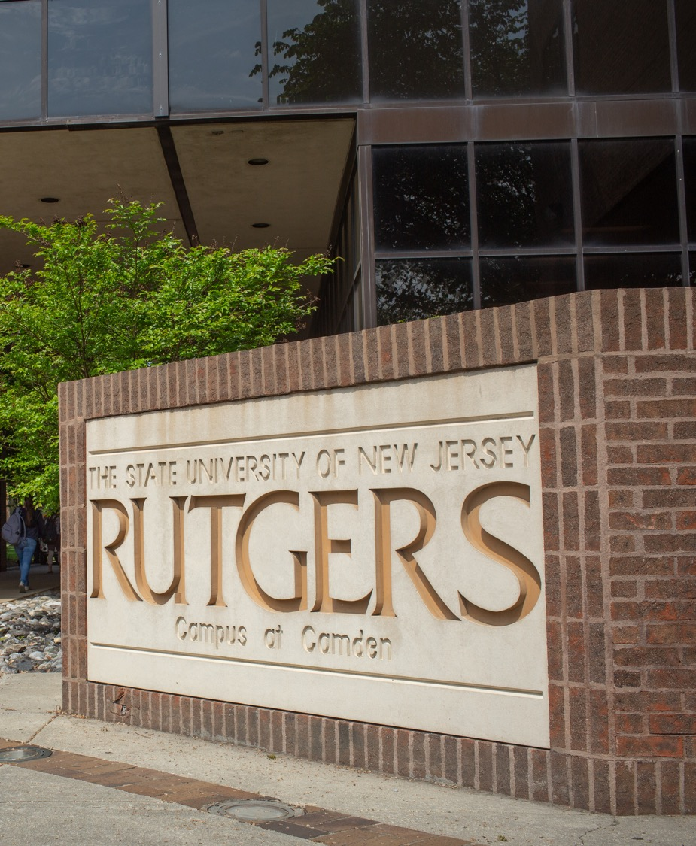
National Designations

Slide 21
New Designation Achieved
Minority Serving Institution
(MSI)
Benefits:
Financial support for students
50 percent of undergraduates are minority students

Slide 22
New Designation Achieved
Aspirational Designations
Goals to Achieve
All three designations by 2026
Minority Serving Institution (MSI)
Hispanic Serving Institution (HSI)
Anchor Institution

Slide 23
On The Move: Achievements and Accolades

Slide 24
Recent Achievements
Dr. Susan Mokhberi, associate professor of history, has been awarded the prestigious 2022 Iran World Book Award at the 2022 Iran Book of the Year Awards.
Mustafa Saqib, Afghani doctoral student, finds a home at Rutgers–Camden through Scholar Rescue Fund.
Dr. Wanda Williams, clinical associate professor of nursing, receives Robert Wood Johnson grant to tackle racial gaps in local breast cancer survival rates.
Rutgers Law School students in Camden shape NJ legislation banning invasive medical exams without prior written consent
Dr. Ozum Zor, assistant professor of marketing, had a research paper accepted for publication in the Journal of Consumer Research, a Financial Times top 50 journal.
Chrissie King, assistant director of the Campus Center, received the Christine A. Chergi Award from the Association of College Unions International Region VII.
Undergraduate biology students won awards for their research at the Annual Biomedical Research Conference for Minority Students.

Slide 25
chancellor@camden.rutgers.edu

