Slide 1

Orientation 2025–2026
Chair: Lucille Foster
Vice Chair: TBD Sept. 19th
Executive Secretary: Taryn Cooper
Administrative Assistant: Morgan Smith
Robert’s Rules: Heather Pierce

Slide 2
Overview of the Orientation
What is the Rutgers University Senate?
Who are the Senators?
How is the Senate managed?
What is involved in Senate Meetings?
What are the Senate Committees?
How do issues reach the Senate?
To whom do I direct questions?

Slide 3
What is the Rutgers University Senate?
It is the principal shared-governance advisory body to the President.
It is the sole institution that represents the entire community of faculty, students, staff, administrators, and alumni to the President of Rutgers and to the Board of Governors.
It exercises legislative authority on certain matters delegated to it by the Board of Governors.

Slide 4
Who are the Senators?
The total entitlements for Senators vary from year-to-year depending on numbers of students and faculty.
Entitlements for lecturers, alumni, and staff are consistent year-to-year.
Typically, the number of voting Senators is approximately 220.

Slide 5

Some Feelings Senators May Experience During Senate:

Slide 6
How is the Senate managed?
The Executive Committee meets prior to each Senate meeting.
Its primary duties involve:
discussion and issuance of charges to committees to investigate and report on matters brought before it
receipt of the committee reports
docketing of reports and other matters for review by the whole Senate
set the agenda for forthcoming Senate meetings
The Executive Committee may act on behalf of the Senate, if necessary, between full Senate meetings.

Slide 7
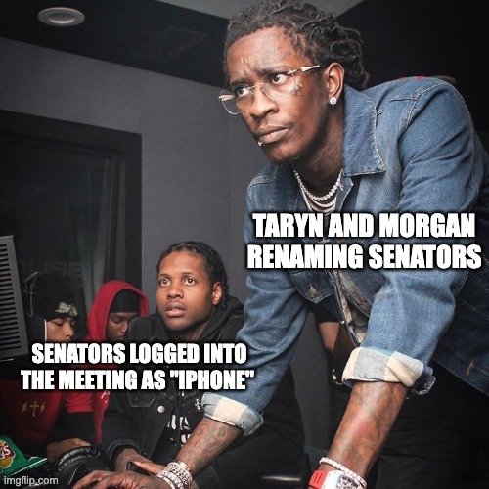
Some Feelings Admin May Experience During Senate:

Slide 8
Senate Meetings
The Senate meets monthly, 8 times each academic year during the fall and spring semesters.
The schedule is available at: senate.rutgers.edu/meetings.
Senators should schedule their availability from 10:00 am to approximately 4:00 pm for Senate business.
The daily schedule for Senate meeting days includes:
10:00-11:50 am: Senate committees
Noon-1:00 pm: Faculty, student, staff, and alumni caucuses
1:10 pm to ~4 pm: full Senate meeting

Slide 9
Here's an example of how you can use your minute

Slide 10
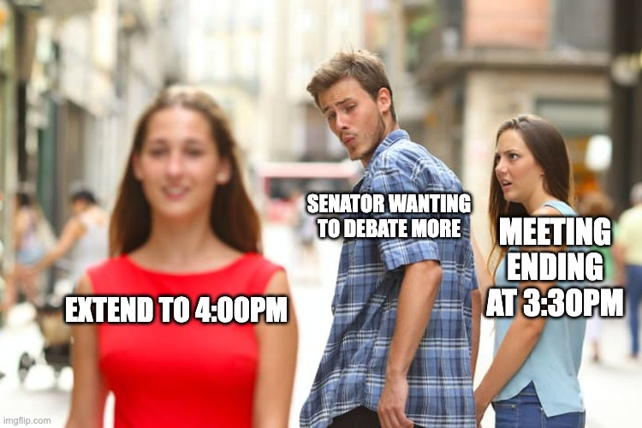
Some Feelings Senators May Experience During Senate:

Slide 11

Some Feelings You May Experience During Senate:

Slide 12
Senate Committees and Panels
Executive Committee
Standing Committees
Academic Standards, Regulations and Admissions Committee (ASRAC)
Access, Belonging, Inclusion, Diversity, and Equity Committee (ABIDE)
Budget and Finance Committee (BFC)
Faculty and Personnel Affairs Committee (FPAC)
Information Technology Committee (ITC)
Instruction, Curricula and Advising Committee (ICAC)
Research and Graduate and Professional Education Committee (RGPEC)
Student Affairs Committee (SAC)
University Structure and Governance Committee (USGC)
Appeals Panel
Nominating Panel

Slide 13
How do issues reach the Senate?
Matters for possible consideration by the Senate should be submitted via the Senate website (https://senate.rutgers.edu/university- senate-charge-proposal)
What is required:
a brief statement of the proposed charge
a short rationale describing the
issue with relevant background information
what committee you anticipate would consider the charge

Slide 14
Who to contact with questions?
admin@senate.rutgers.edu
Taryn Cooper, Executive Secretary tc738@senate.rutgers.edu
Lucy Foster, Chair lufoster@rutgers.edu or 917-974-2649
Morgan Smith, Administrative Assistant man145@senate.Rutgers.edu
Senate website: http://senate.rutgers.edu
9

Slide 15
Questions?
First Senate & Committee Meetings:
Fri. Sept. 19
10

