Slide 1
Rutgers University – Newark: Engineering Opportunity Pathways for Social Mobility
March 27, 2026

Slide 2
We are not a one size fits all University.
Notes:
Rows of monitors fading into the background
(Intermediate)
To reproduce the shape effects on this slide, do the following:
On the Home tab, in the Slides group, click Layout, and then click Blank.
On the Home tab, in the Drawing group, click Shapes, and then under Basic Shapes click Rounded Rectangle (second option from the left). On the slide, drag to draw a rectangle.
Drag the yellow diamond adjustment handle to the left to decrease the amount of rounding on the corners of the rectangle.
Select the rectangle. Under Drawing Tools, on the Format tab, in the Size group, do the following:
In the Shape Height box, enter 1.38”.
In the Shape Width box, enter 1.75”.
Also under Drawing Tools, on the Format tab, in the Shape Styles group, click the Format Shape dialog box launcher. In the Format Shape dialog box, click Fill in the left pane, select Solid fill in the Fill pane, and then do the following:
Click the button next to Color, click More Colors, and then in the Colors dialog box, on the Custom tab, enter values for Red: 54, Green: 65, Blue: 118.
In the Transparency box, enter 45%.
Also in the Format Shape dialog box, click Line Color in the left pane, and then in the Line Color pane select No line.
Also in the Format Shape dialog box, click 3-D Format in the left pane. In the 3-D Format pane, under Bevel, click the button next to Top, and then under Bevel click Relaxed Inset (first row, second option from the left). Next to Top, in the Width box, enter 6 pt, and in the Height box, enter 6 pt.
Also in the Format Shape dialog box, click Reflection in the left pane. In the Reflection pane, click the button next to Presets, and then under Reflection Variations click Tight Reflection, touching (first row, first option from the left).
On the Home tab, in the Clipboard group, click the arrow under Paste, and then click Duplicate. Repeat this process to create a total of five rectangles.
On the Home tab, in the Drawing group, click Arrange, point to Align, and then do the following:
Click Align to Slide.
Click Align Middle.
Click Distribute Horizontally.
On the Home tab, in the Drawing group, click Arrange, and then click Group.
Select the group. On the Home tab, in the bottom right corner of the Drawing group, click the Format Shape dialog box launcher. In the Format Shape dialog box, click 3-D Rotation in the left pane. In the 3-D Rotation pane, click the button next to Presets, and then under Perspective, click Perspective Below (first row, fourth option from the left).
Select the group. On the Home tab, in the Clipboard group, click the arrow to the right of Copy, and then click Duplicate. On the slide, drag the second group above the first group.
Under Drawing Tools, on the Format tab, in the bottom right corner of the Size group, click the Size and Position dialog box launcher. In the Format Shape dialog box, click Size in the left pane. In the Size pane, under Scale, do the following:
Select Lock aspect ratio.
In the Height box, enter 85%.
Also in the Format Shape dialog box, click Fill in the left pane. In the Fill pane, select Solid fill, and then in the Transparency box, enter 55%.
Select the second group. On the Home tab, in the Clipboard group, click the arrow to the right of Copy, and then click Duplicate. On the slide, drag the third group above the second group.
Under Drawing Tools, on the Format tab, in the bottom right corner of the Size group, click the Size and Position dialog box launcher. In the Format Shape dialog box, click Size in the left pane. In the Size pane, under Scale, do the following:
Select Lock aspect ratio.
In the Height box, enter 85%.
On the Home tab, in the bottom right corner of the Drawing group, click the Format Shape dialog box launcher. In the Format Shape dialog box, click Fill in the left pane. In the Fill pane, select Solid fill, and then in the Transparency box, enter 65%.
Select the third group. On the Home tab, in the Clipboard group, click the arrow to the right of Copy, and then click Duplicate. On the slide, drag the fourth group above the third group.
Under Drawing Tools, on the Format tab, in the bottom right corner of the Size group, click the Size and Position dialog box launcher. In the Format Shape dialog box, click Size in the left pane. In the Size pane, under Scale, do the following:
Select Lock aspect ratio.
In the Height box, enter 85%.
Also in the Format Shape dialog box, click Fill in the left pane. In the Fill pane, select Solid fill, and then in the Transparency box, enter 75%.
Select the fourth group. On the Home tab, in the Clipboard group, click the arrow to the right of Copy, and then click Duplicate. On the slide, drag the fifth group above the fourth group.
Under Drawing Tools, on the Format tab, in the bottom right corner of the Size group, click the Size and Position dialog box launcher. In the Format Shape dialog box, click Size in the left pane. In the Size pane, under Scale, do the following:
Select Lock aspect ratio.
In the Height box, enter 85%.
Also in the Format Shape dialog box, click Fill in the left pane. In the Fill pane, select Solid fill, and then in the Transparency box, enter 85%.
Select the fifth group. On the Home tab, in the Clipboard group, click the arrow to the right of Copy, and then click Duplicate. On the slide, drag the sixth group above the fifth group.
Under Drawing Tools, on the Format tab, in the bottom right corner of the Size group, click the Size and Position dialog box launcher. In the Format Shape dialog box, click Size in the left pane. In the Size pane, under Scale, do the following:
Select Lock aspect ratio.
In the Height box, enter 85%.
Also in the Format Shape dialog box, click Fill in the left pane. In the Fill pane, select Solid fill, and then in the Transparency box, enter 95%.
Using the ruler as a guide, drag the groups into rows on the slide so that the top and bottom margins are approximately 1.75”. On the View tab, in the Show/Hide group, clear Ruler.
Press CTRL-A to select all of the groups. On the Home tab, in the Drawing group, click Arrange, point to Align, and then do the following:
Click Align Selected Objects.
Click Distribute Vertically.
Click Align to Slide.
Click Align Center.
On the Home tab, in the Drawing group, click Arrange, and then click Group.
On the Home tab, in the Drawing group, click Arrange, point to Align, and then do the following:
Point to Align, and then click Align to Slide.
Point to Align, and then click Align Middle.
Point to Align, and then click Align Center.
To reproduce the background effects on this slide, do the following:
On the Design tab, in the Background group, click Background Styles, and then click Format Background. In the Format Background dialog box, click Fill in the left pane, select Gradient fill in the Fill pane, and then do the following:
In the Type list, select Radial.
Click the button next to Direction, and then click From Center (third option from the left).
Under Gradient stops, click Add gradient stops or Remove gradient stops until three stops appear in the slider.
Also under Gradient stops, customize the gradient stops as follows:
Select the first stop in the slider, and then do the following:
In the Position box, enter 33%.
Click the button next to Color, and then under Theme Colors click White, Background 1 (first row, first option from the left).
In the Transparency box, enter 0%.
Select the next stop in the slider, and then do the following:
In the Position box, enter 67%.
Click the button next to Color, click More Colors, and then in the Colors dialog box, on the Custom tab, enter values for Red: 228, Green: 233, Blue: 236.
In the Transparency box, enter 0%.
Select the last stop in the slider, and then do the following:
In the Position box, enter 100%.
Click the button next to Color, click More Colors, and then in the Colors dialog box, on the Custom tab, enter values for Red: 178, Green: 186, Blue: 210.
In the Transparency box, enter 0%.

Slide 3

We focus on key metrics because we continue to design around our students’ reality using student-centered engineering and value stream analysis.

Slide 4


Slide 5

Who We Serve
Our students are talented, intelligent and time-constrained
When time is scarce and systems are confusing, the default outcome is attrition.
Our job is to remove friction and add fuel to the value stream.
56% Pell Eligible
56% First Generation*
88% Commuter
88% In-state; 94% w/in 75 miles
*Parents have no college degree.

Slide 6
Student Success
Note: The 1-year retention rate for 2025, the 4-year graduation rates for 2023–2025, and the 6-year graduation rate for 2025 are based on preliminary (non-IPEDS) data. The ranking graduation rates reflect a 4-year rolling average of IPEDS graduation rates data.

Slide 7
The business of student success and thriving requires us to design an ecosystem that facilitates movement through the value stream.

Slide 8



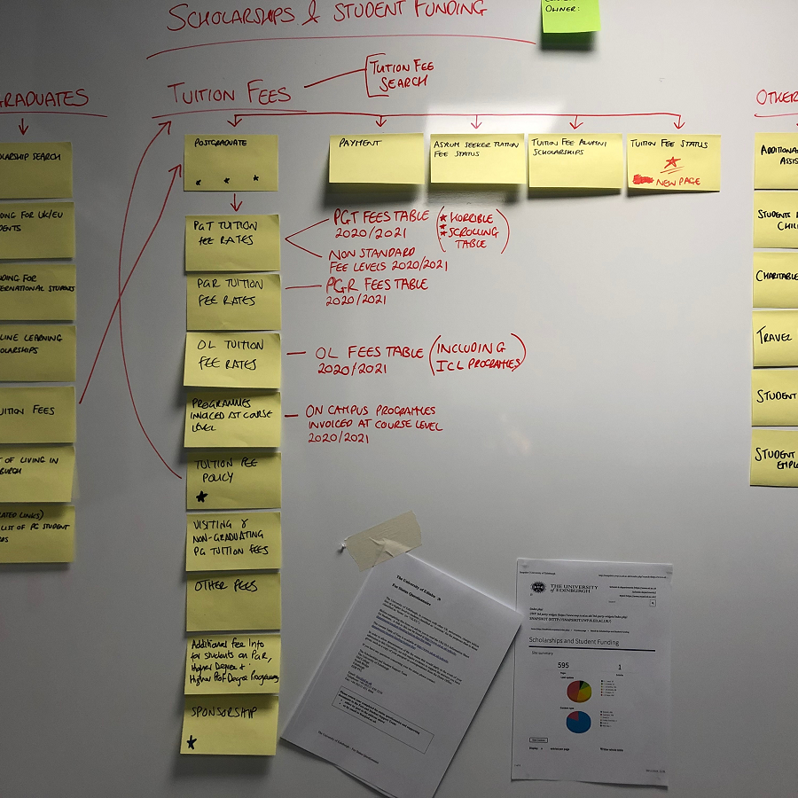
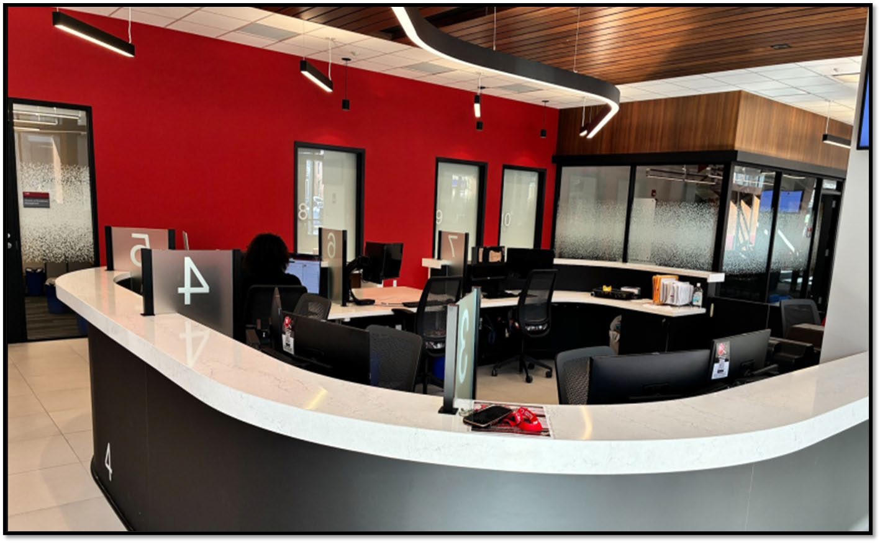

Examples of Ecosystem Components
Braven Career Accelerator
One Stop
Wrap-around Supports
Student Journey Mapping
Centralizes services so students focus less on navigating systems and more on achieving their goals.
CARE Team supports mental health, food and housing, clothing and living necessities.
Student-centered process to understand facilitators and barriers along the journey.
Empowers students with career skills, social capital and high-impact leadership practices.

Slide 9


Slide 10

We use data and student-centered approaches to design the institution such that a low-socioeconomic status student working two jobs with family demands is no less likely to succeed than a student born to wealth or privilege. (Paraphrased from Won’t Lose this Dream, A. Gumbel).

Slide 11





“Won’t Lose This Dream!”

