Slide 1

Orientation 2026-27
Chair: Anna Haley
Vice Chair: Paul Boxer
Executive Secretary: Taryn Cooper
Administrative Assistant: Morgan Smith
Robert’s Rules Trainer: Heather Pierce
Notes:
ANNA

Slide 2
Agenda
What is the Rutgers University Senate?
Who are the Senators?
How is the Senate managed?
Senate committees and panels
How does the Senate do its work?
Senate meeting days
So. many. feelings….
To whom do I direct questions?
Notes:
ANNA

Slide 3
What is the Rutgers University Senate?
the principal shared governance advisory body to the President
the sole institution that represents all faculty, students, staff, alumni, and administrators – across all 4 “Chancellor-Led Units” – before the Rutgers President and Board of Governors
per University policy, exercises legislative authority on certain matters delegated to it by the Board of Governors
Notes:
ANNA & PAUL

Slide 4
Who are the Senators?
A unit’s entitlements to full-time faculty Senate representation are based on its numbers of students and faculty
Senate Bylaws - Article I:Letter D, sections d-f sets full-time faculty algorithm
Senate entitlements for staff (20 total: 7 NB, 6 RH, 4 Newark, 3 Camden), Lecturers (8 total: 2 per CLU), and alumni (8) are consistent year-to-year
Voting Senators usually number about 220
Notes:
TARYN

Slide 5
How is the Senate managed?
The Executive Committee meets prior to each Senate meeting.
The EC’s primary duties involve:
  discussion approval, and assignment of charges to committees
  receipt and review of committee reports/resolutions, and docketing them for review by the whole Senate
  setting the agenda for forthcoming Senate meetings
The EC may act on behalf of the Senate, if necessary, between full Senate meetings.
Notes:
TARYN & MORGAN

Slide 6
Senate committees and panels
Executive Committee (representing all CLUs and constituencies, elected by the Senate)
Standing Committees (co-chairs elected by their committees)
  Academic Standards, Regulations and Admissions Committee (ASRAC)
  Access, Belonging, Inclusion, Diversity, and Equity Committee (ABIDE)
  Budget and Finance Committee (BFC)
  Faculty and Personnel Affairs Committee (FPAC)
  Information Technology Committee (ITC)
  Instruction, Curricula and Advising Committee (ICAC)
  Research and Graduate and Professional Education Committee (RGPEC)
  Student Affairs Committee (SAC)
  University Structure and Governance Committee (USGC)
Elections Committee
Ad Hoc Committees
Appeals Panel
Notes:
TARYN & MORGAN (ESP. MORGAN AS SHE HANDLES COMMITTEE ASSIGNMENTS)

Slide 7
How does the Senate do its work?: Charges, reports, and resolutions
A proposed “charge” (work focus) is submitted to and reviewed/approved by EC, then assigned to a committee
Committee conducts research and drafts report/recommendations/resolution
Committee votes report/recommendations/resolution out of committee, sending it to the EC for review and docketing to a Senate meeting agenda
All-Senate presentation, discussion, and vote
Senate-approved reports/resolutions sent to President
Notes:
ANNA (PAUL CHIME IN)

Slide 8
How does the Senate do its work?: You
Shared governance is not a spectator sport.
Senate service involves:
  Before meetings: Reading reports docketed to a given agenda
  Attending monthly Senate meeting days
  After meetings: providing updates to your constituents about Senate work, and communicating their concerns back to the Senate (via: your committee, other committees, the EC, and/or Senate leadership)
  Between meetings: contributing to research and writing of your committee’s charges
Notes:
PAUL? (ANNA CHIME IN)

Slide 9
Senate meetings
The Senate has monthly meeting days:
              8 times each academic year (schedule: senate.rutgers.edu/meetings)
              Over Zoom
              Fridays from 10am to ~ 4pm:
  10:00-11:30 am: Senate committees
  Noon-1:00 pm: Senate constituent caucuses
  1:10 pm to ~4 pm: full Senate meeting
Notes:
ANNA

Slide 10
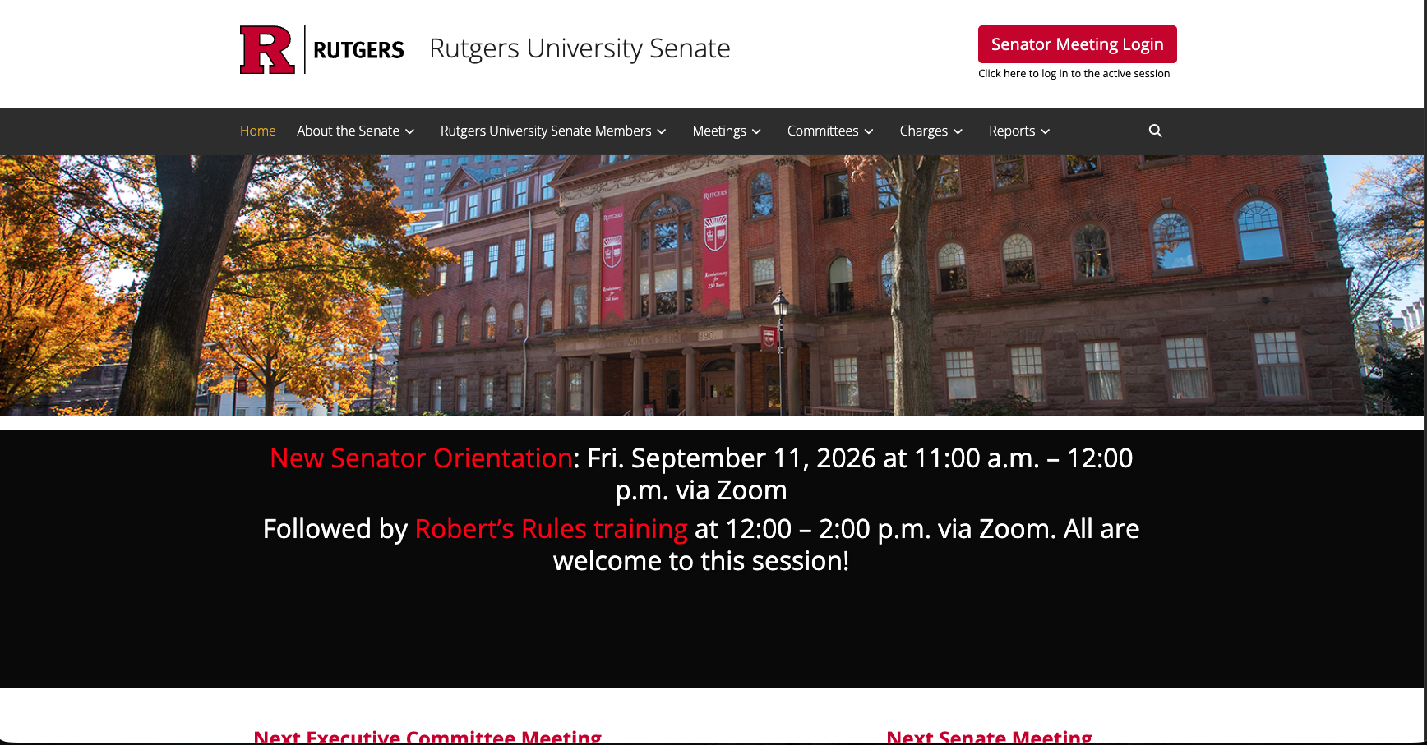
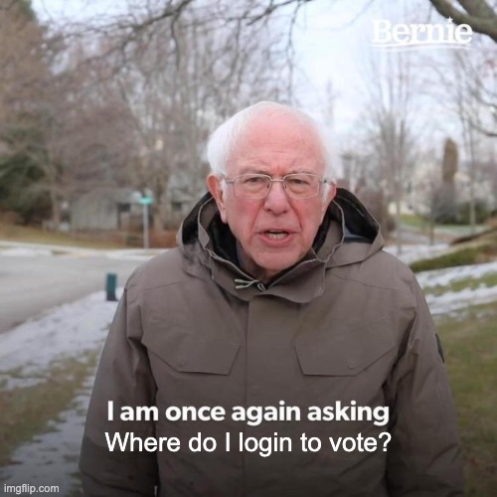
Some feelings Senators may experience during Senate meetings:
Notes:
TARYN & MORGAN

Slide 11
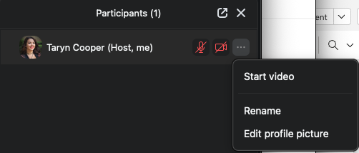
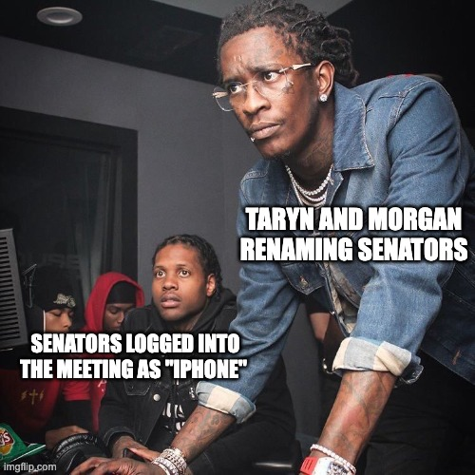
Some feelings Senate admin may experience during Senate meetings:
Notes:
TARYN & MORGAN

Slide 12
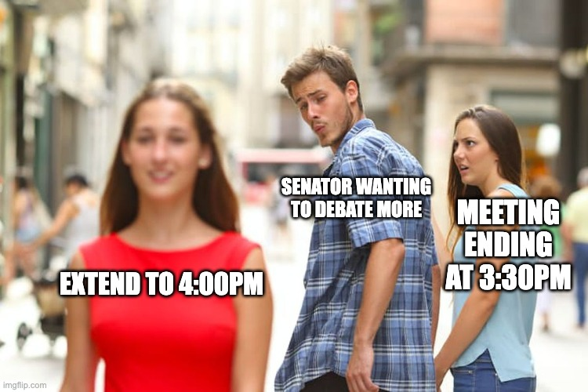
Some feelings Senators may experience during Senate meetings:

Slide 13
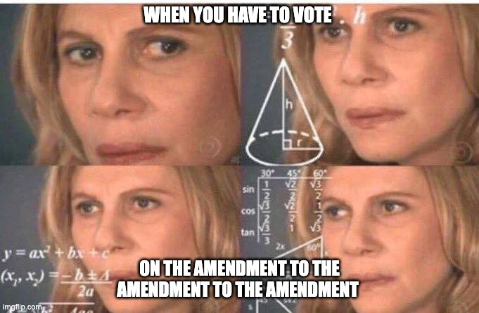
Some feelings Senators may experience during Senate meetings:
Notes:
TARYN & MORGAN

Slide 14
Whom to contact with questions?
Prof. Anna Haley, Chair: ahaley@ssw.rutgers.edu
Prof. Paul Boxer, Vice Chair: pboxer@psychology.rutgers.edu
Taryn Cooper, Executive Secretary: tc738@senate.rutgers.edu
Morgan Smith, Administrative Assistant: man145@senate.rutgers.edu
Senate website: http://senate.rutgers.edu
9

Slide 15
Questions?
First Senate meeting day (10am - 4pm):
Fri. Sept. 18
10

